Slide 1
General Orientation
Special Olympics south Carolina

Slide 2
SPECIAL OLYMPICS MISSION
To provide year-round sports training and athletic competition in a variety of Olympic-type sports for people with intellectual disability, giving them continuing opportunities to develop physical fitness, demonstrate courage, experience joy and participate in a sharing of gifts, skills, and friendship with their families, other Special Olympics athletes and the community.

Slide 3
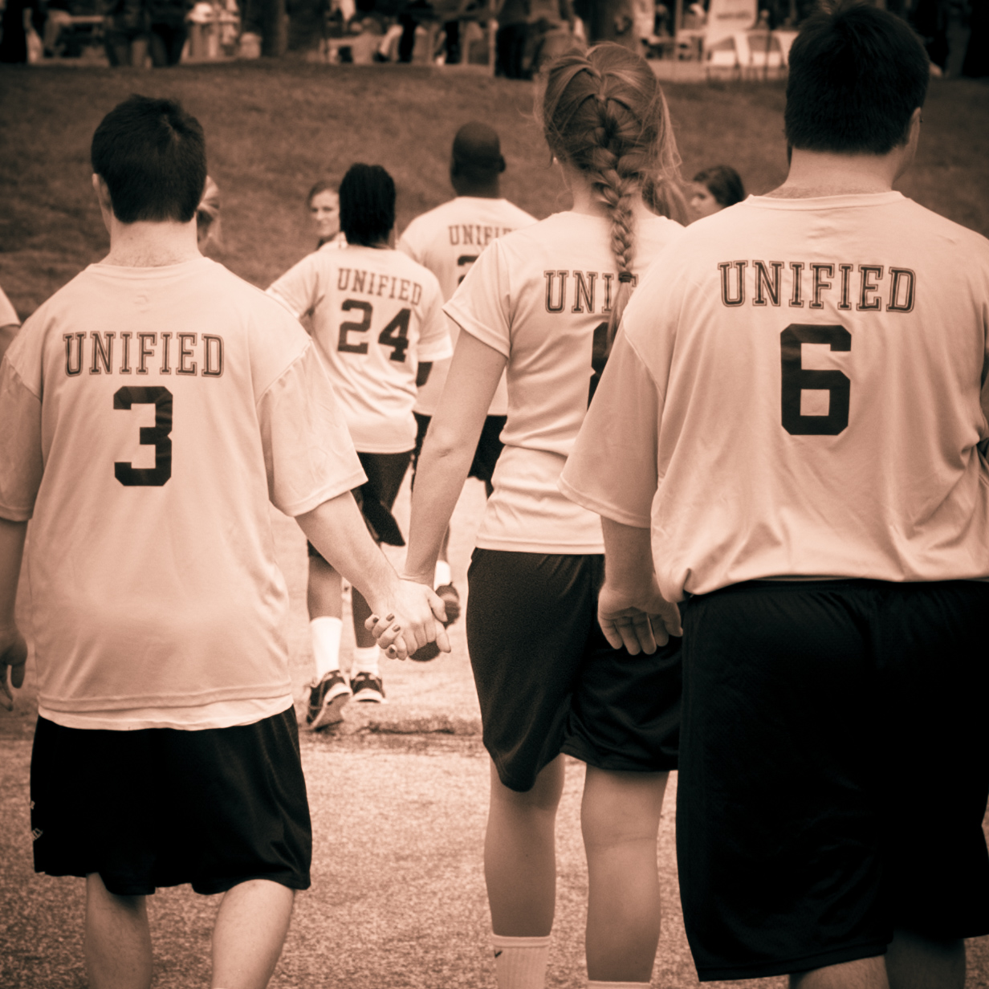
“Special Olympics is humanity’s greatest classroom, where lessons of ability, acceptance, and inclusion are taught on the fields of competitions by our greatest teachers- the athletes.” -Tim Shriver

Slide 4
Athlete oath
“Let me win. But if I cannot win, let me be brave in the attempt.”

Slide 5
You need to know…
SOSC = Special Olympics South Carolina
SOI = Special Olympics Incorporated
SOSC has 30,707 athletes and conducts more than 490 sports competitions per year supported by over 25,000 volunteers and 2613 coaches

Slide 6
3 areas of focus
Sports
Education
Health

Slide 7
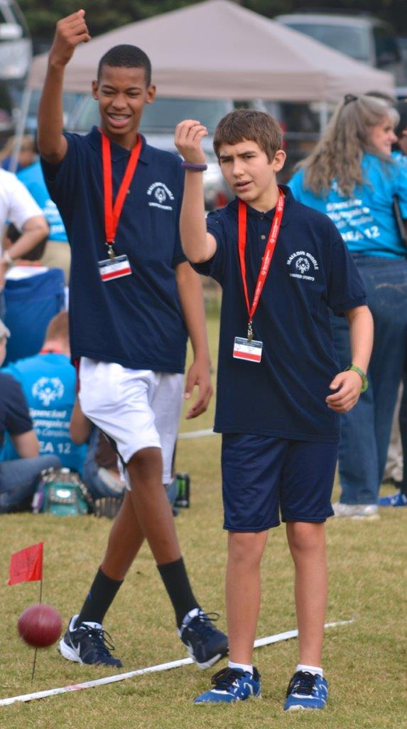
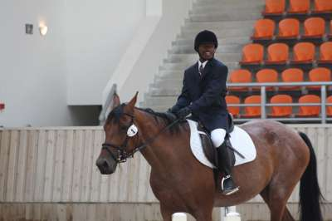
Sports

Slide 8
9 facts you need to know…
SO is for children & adults with intellectual disabilities
SO is free to athletes
SO athletes compete as early as age 8
SO is year-round
SO is worldwide (more than 180 sanctioned programs)
SOSC offers 26 different sports (SOI, 35)
SO offers individual as well as team sports
SO stresses training as well as competition, athletes must train at least 8 weeks prior to competition
SO is sanctioned by International Olympic Committee

Slide 9
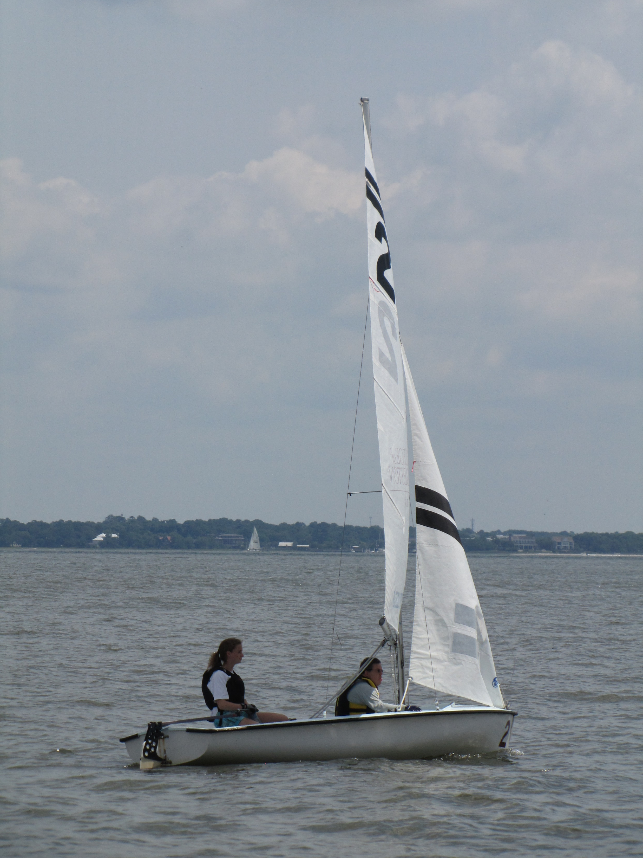
Special Olympics has
Governing bodies
Levels
Divisioning
Inclusion
Opportunities for Advancement

Slide 10
You may know…
All SO competitions follow the Official SO Sports Rules, which have been adapted from official rules of the National Governing Body or International Federation of each sport offered by SO.
SO offers various levels of competition based on ability levels.

Slide 11
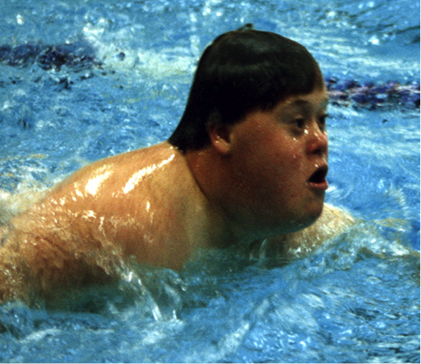
Summer/Fall sports Offered by SOSC
Aquatics
Basketball
Bowling
Equestrian
Football (soccer)
Golf
Artistic Gymnastics
Rhythmic Gymnastics
Powerlifting
Roller Skating
Softball
Tennis
Track & Field
Volleyball

Slide 12
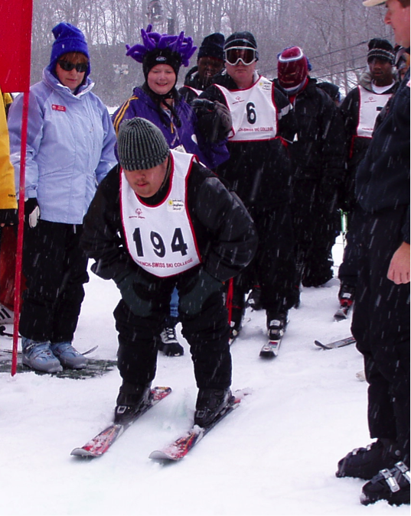
Winter Sports by SOSC
Alpine Skiing
Snowboarding
Figure Skating

Slide 13
Unified sports
Unified Sports is combining approximately equal numbers of Special Olympics athletes with athletes without intellectual disabilities (called Unified Partners) on sports teams for training and competition.
Unified Partners and SO Athletes should have similar sports skills.
Unified Sports is offered in both individual (an athlete and unified partner paired together) and team sports.

Slide 14
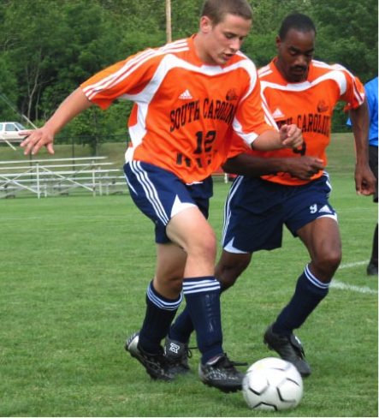
Unified sports
Aquatics
Badminton
Basketball
Bocce
Bowling
Cheerleading
Flag Football
Golf
Artistic Gymnastics
Rhythmic Gymnastics
Kayaking
Sailing
Soccer
Softball
Tennis
Track & Field
Volleyball

Slide 15
4 essential elements of special Olympics programs
Coaches’ Training
Athletes’ Training
Divisioning & Competition
Olympic-style Competition/Events

Slide 16
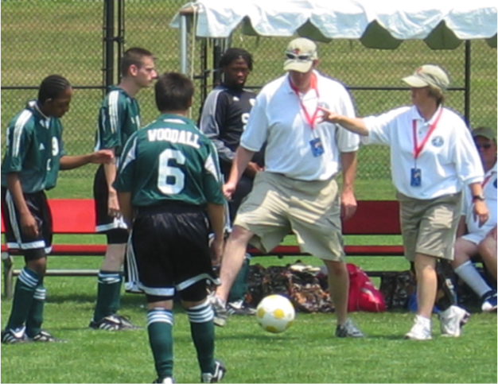
Coaches’ education
Special Olympics depends on its coaches to be well informed on not only the rules of the sport but also coaching techniques and impassioned in their delivery.
We offer certification options in sports skills, tactics for coaching individuals with intellectual disabilities, and continuing education such as first aid courses.
Once completed, we require 10 practicum hours and a recertification process of every 3 years to keep our coaches fresh and energized.
In deciding number of coaches per team or group, coaches are asked to follow a 4 athletes to 1 coach ratio. (4:1)

Slide 17
Levels of competition
Every ability level is accommodated in Special Olympics in a variety of sports.
Developmental
25m assisted walk (Athletics), 15m flotation race (Aquatics), MATP
Individual Skills
Adapted events for many Individual and Team sports such as Basketball, Golf, Soccer, Softball, Tennis, or Volleyball
Modified Team Events
3-on-3 Basketball, 5-a-side Soccer, 9-hole alternate shot Golf Competition
Team Events
Unified Sports

Slide 18
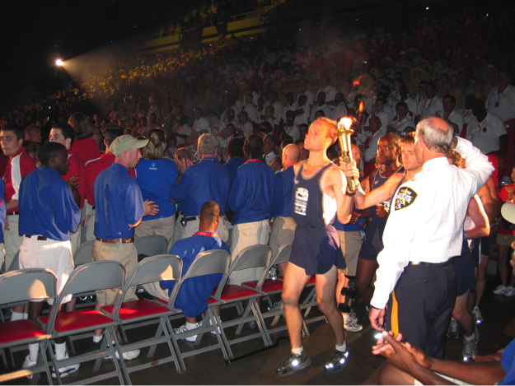
Opening ceremonies
Should Include
Parade of Athletes
Recitation of the SO Athlete Oath
Presentation of the Flame of Hope
Can Include
National Anthem/Pledge of Allegiance
Presentation of Colors
Speaker from the Community
Declaration of the Opening of Games by Guest of Honor
Live Entertainment

Slide 19
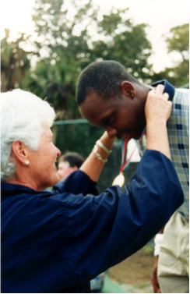
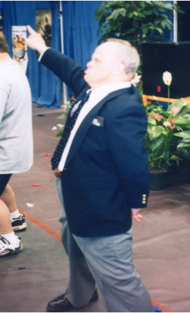
Awards & closing ceremonies
Each competitor is awarded through ribbons on the local level and medals on the state, national, or international level. Places are awarded 1st through 8th with those who are disqualified receiving “Participant Ribbons”
State, national and international competitions are celebrated through Closing Ceremonies which acknowledges the accomplishments through short programs and a Victory Dance.

Slide 20
Sosc competition opportunities
Summer Games, May
Aquatics
Athletics
Badminton
Masters Bocce
Bowling (under 21)
Artistic Gymnastics
Rhythmic Gymnastics
Powerlifting
Softball
Fall Games, November
Bocce (under 21)
Masters Bowling
Disc Golf
Golf
Flag Football
Soccer
Volleyball
One Day Tournaments
Basketball
(Columbia, April)
Cheerleading
(Columbia, March)
Kayaking
(Charleston, Aug.)
Sailing
(Charleston, June)
Equestrian
(Aiken, June)
Tennis
(Columbia, September)

Slide 21
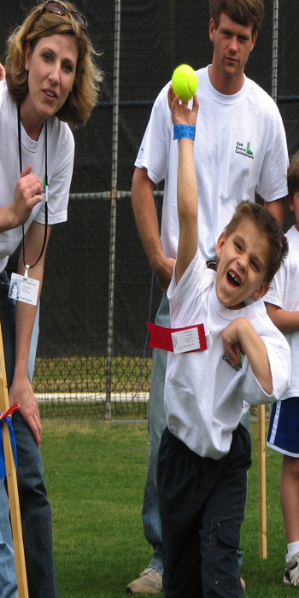
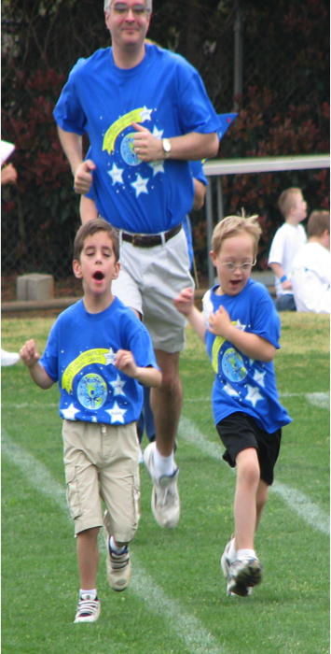
Young athletes program
Young Athletes Program is for athletes 2-7 years old designed to prepare them for sports participation by increasing strength and coordination while developing group play.

Slide 22
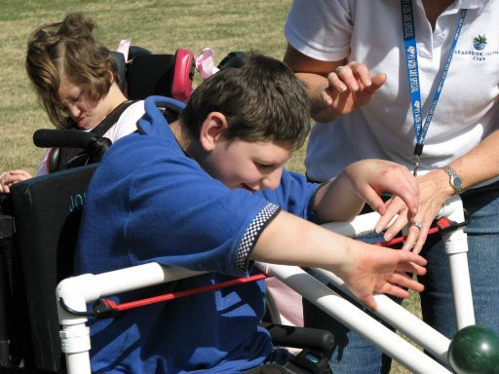
Motor activities training programs
Motor Activities Training Program is designed for athletes with severe motor limitations who do not possess the physical skills to participate in Special Olympics sports. They meet challenges that are designed for both mental and physical development.

Slide 23
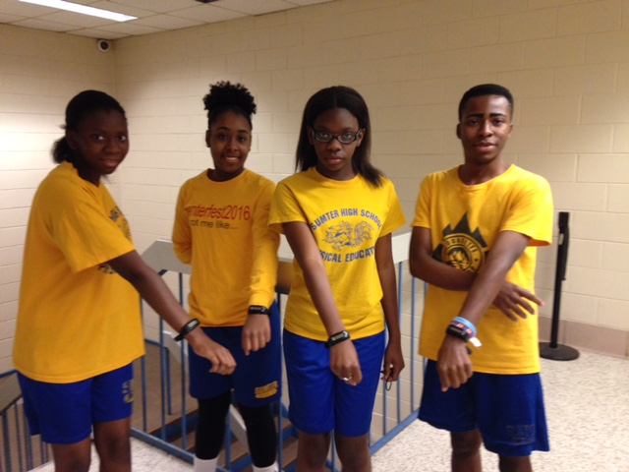
Health

Slide 24
Health disparities
Individuals with ID is the most underserved health group worldwide.
Most health issues for individuals with ID are not a result of their disabilities, rather, poor health care, poor education and poor health promotion.
Special Olympics is the #1 health provider for individuals with intellectual disabilities.

Slide 25
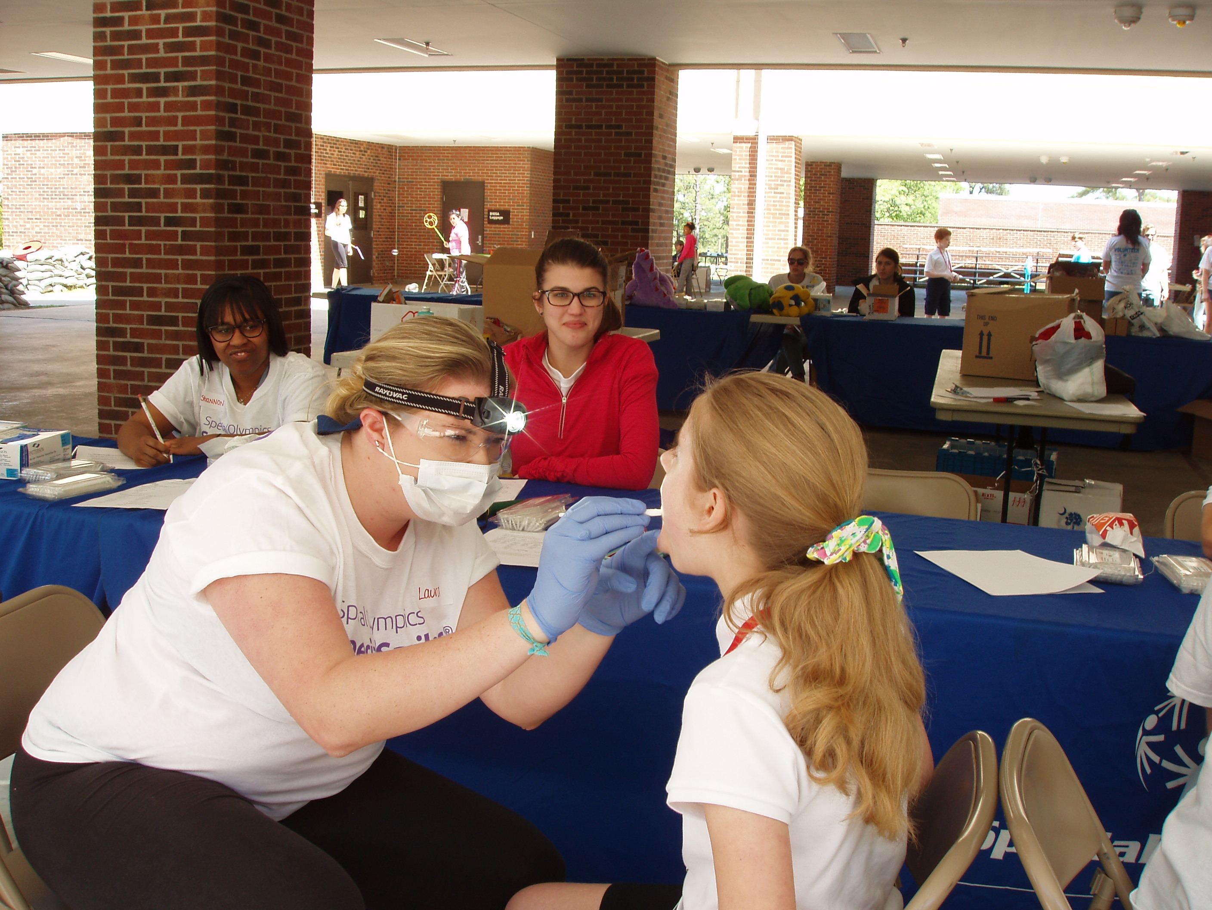
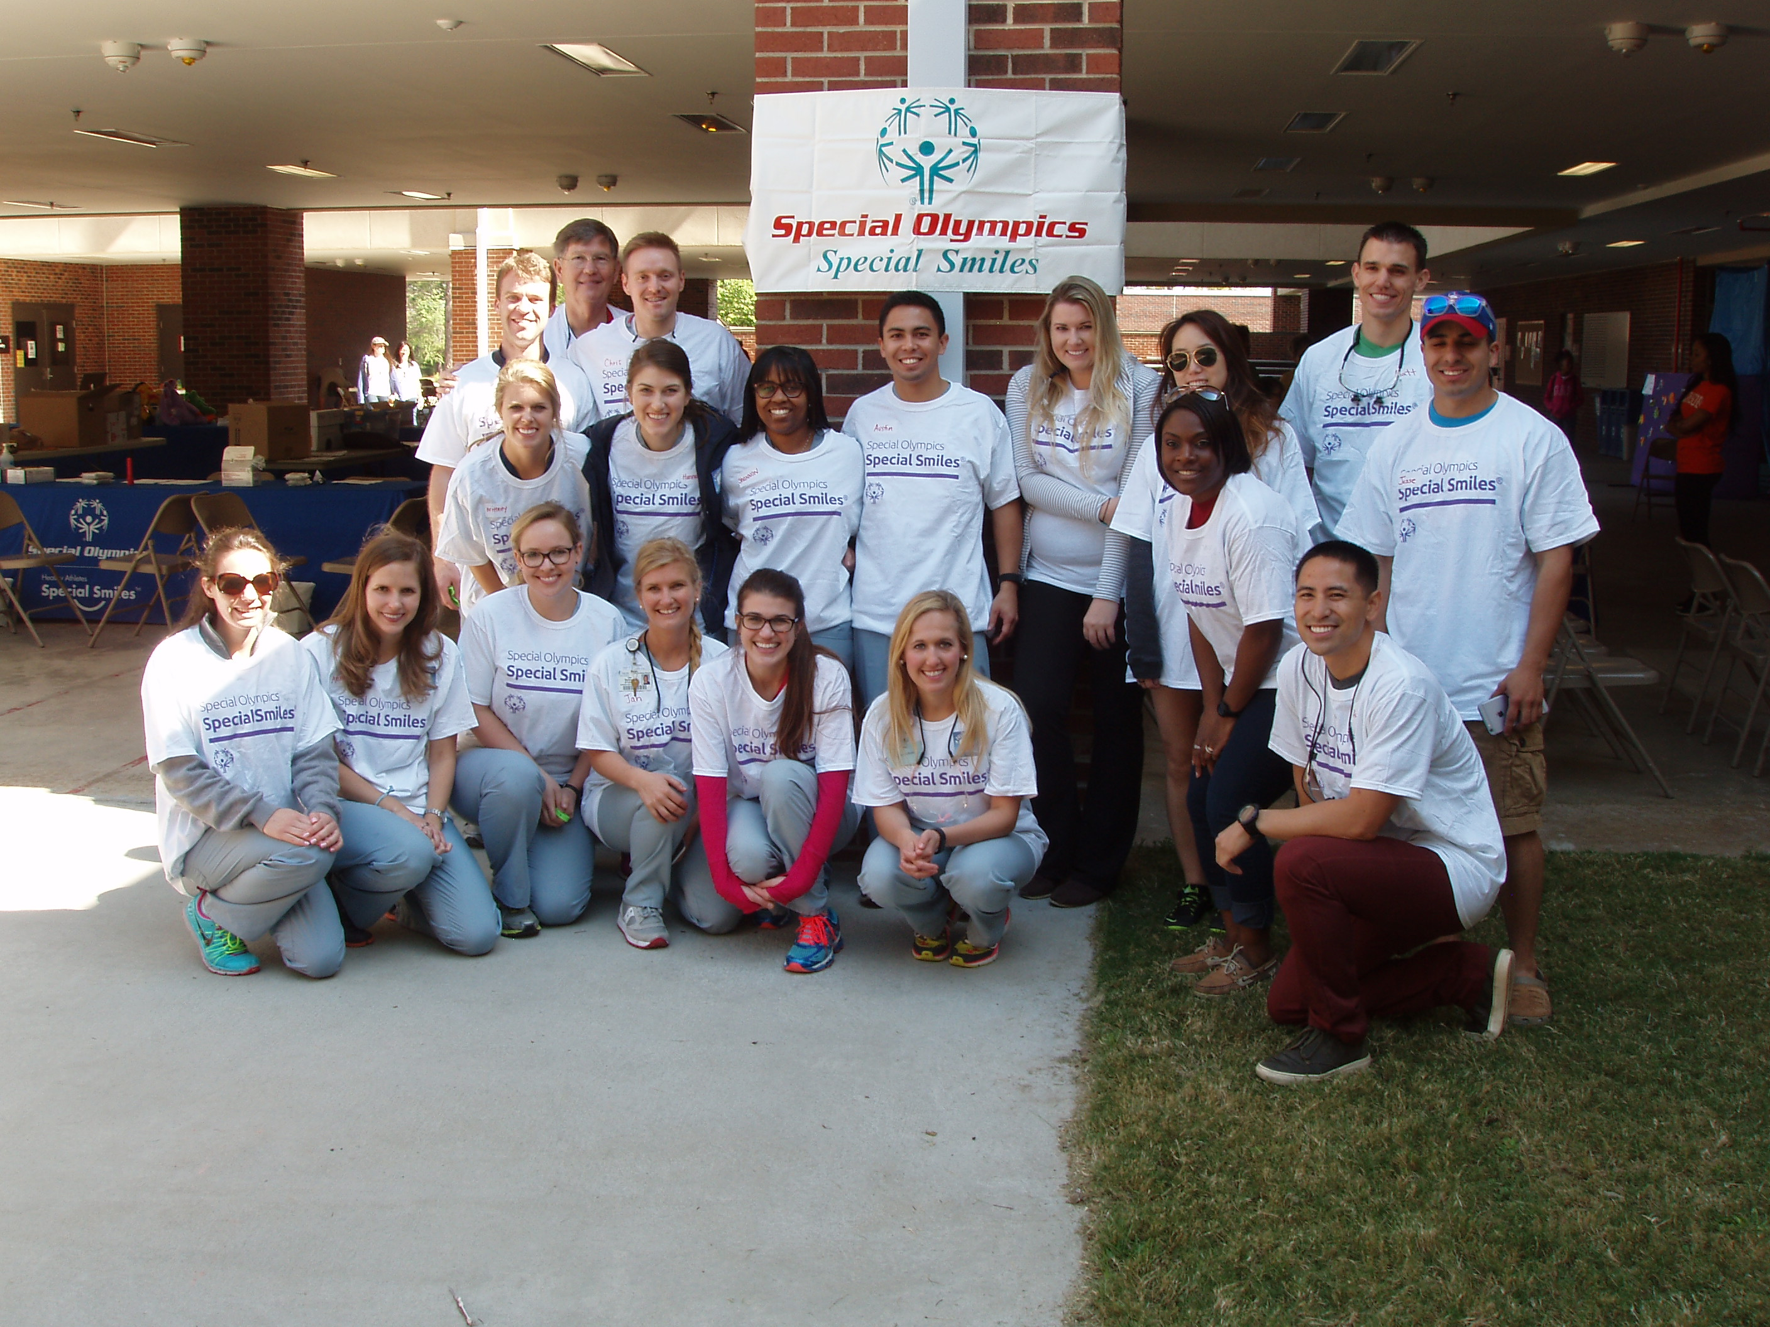
Healthy athletes programs
The Healthy Athlete Mission is to provide health services and to train other health professionals to work with individuals with intellectual disabilities.

Slide 26
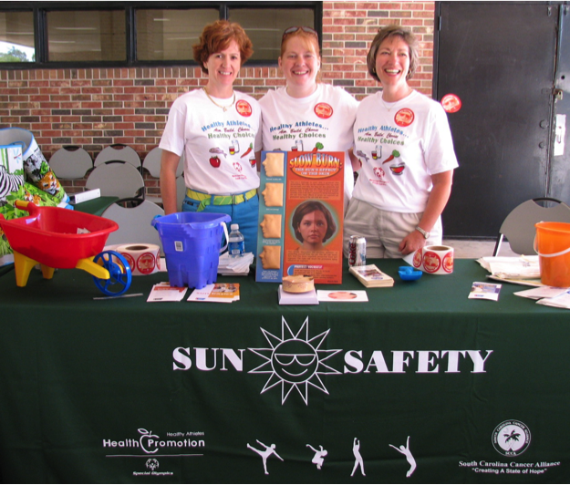
Healthy athletes programs
During Special Olympics competitions, athletes can receive a variety of free health screenings and services in a series of clinics conducted by health care professionals. These professionals are specifically trained to meet the health needs of persons with intellectual and developmental disabilities.
FitFeet
FUNFitness
Healthy Hearing
Opening Eyes
Special Smiles
Sun Safety
Health Promotion

Slide 27
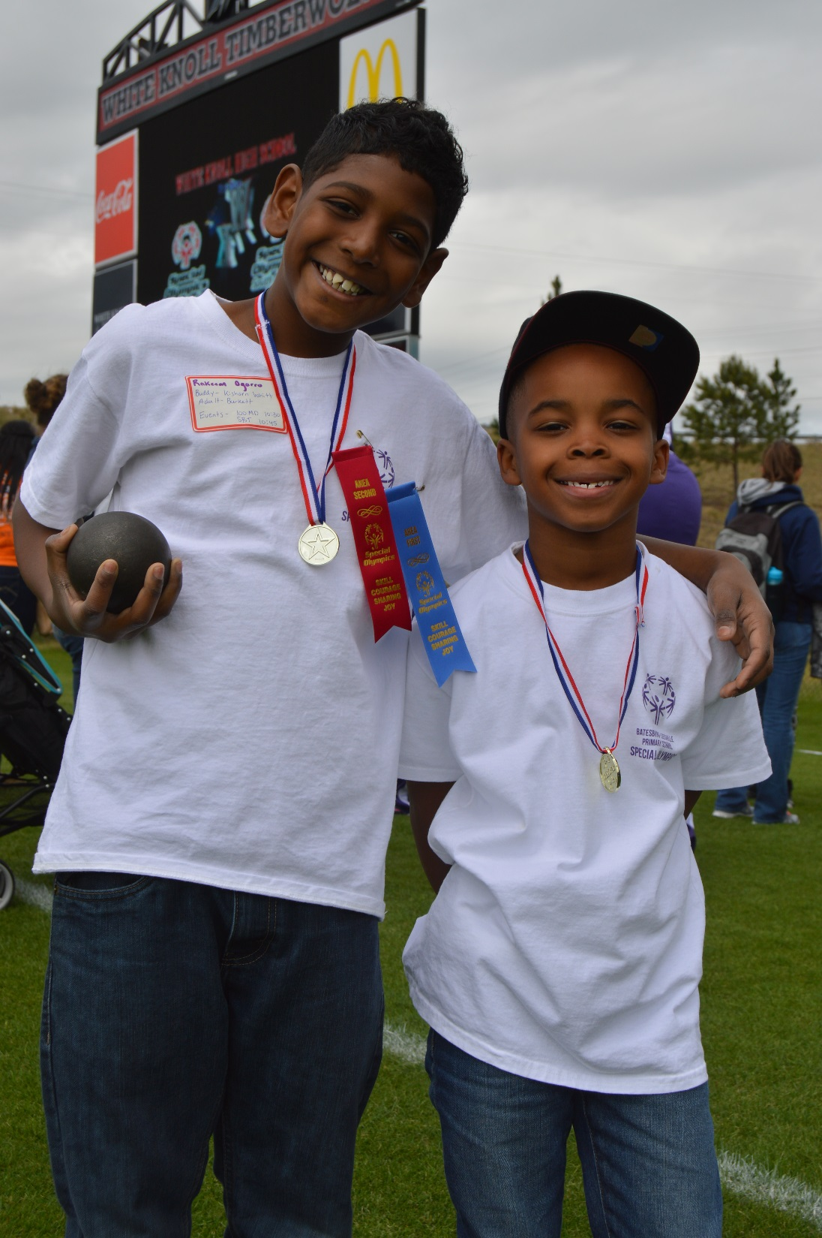
Education

Slide 28
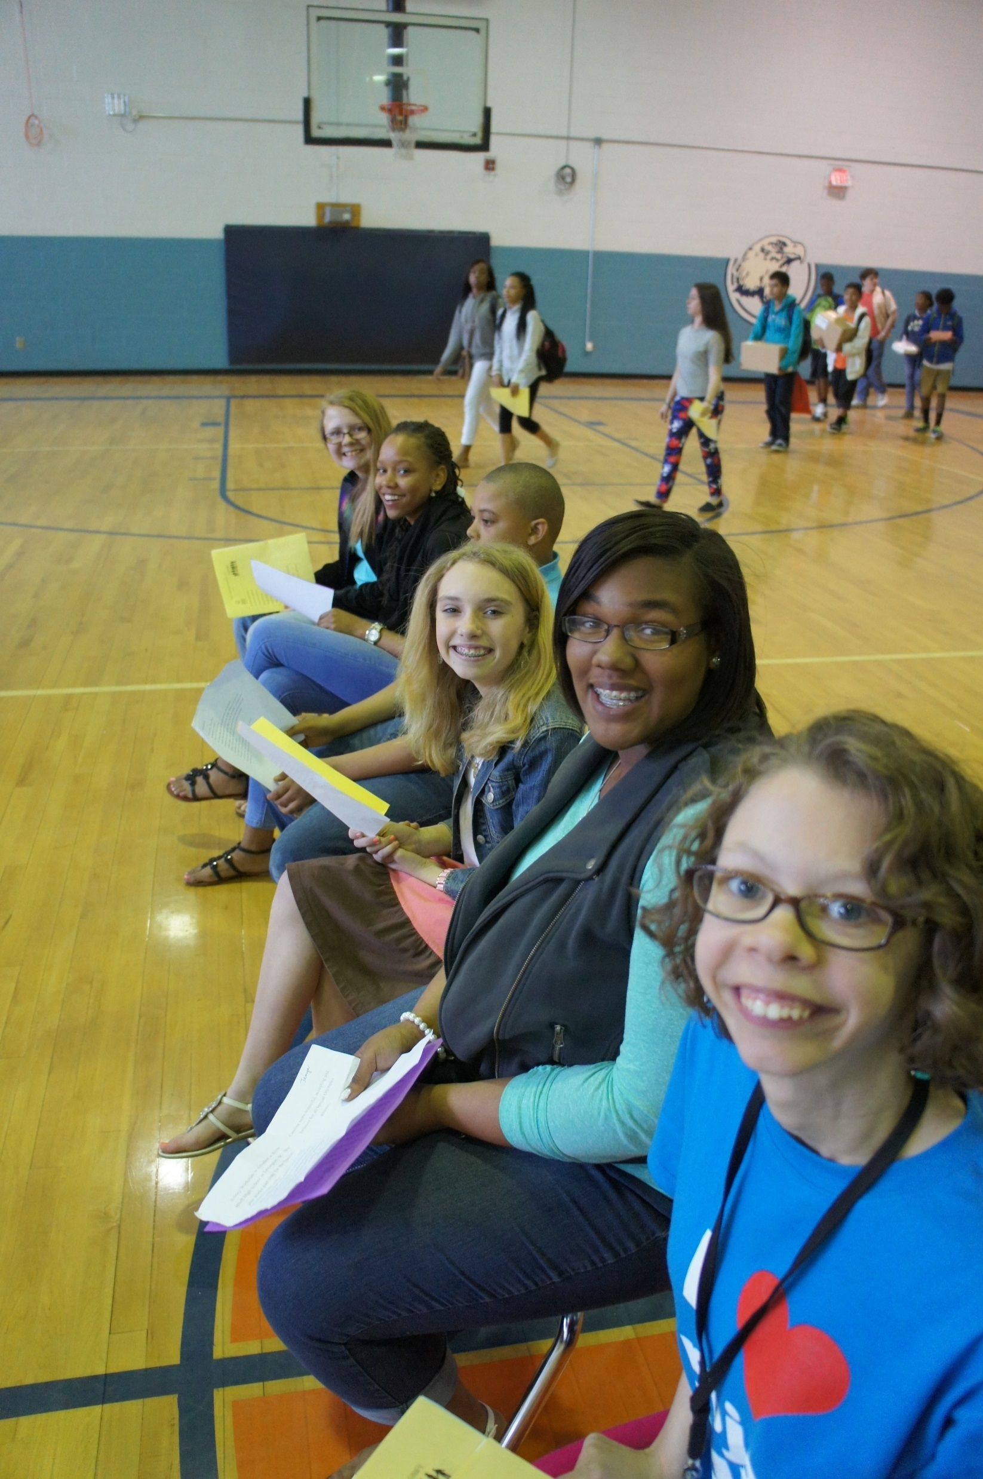
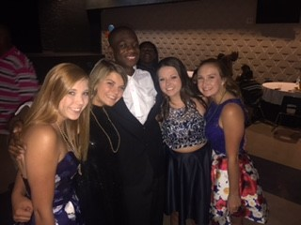
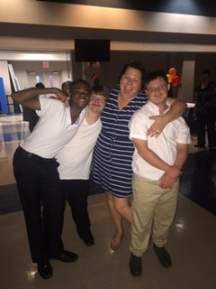
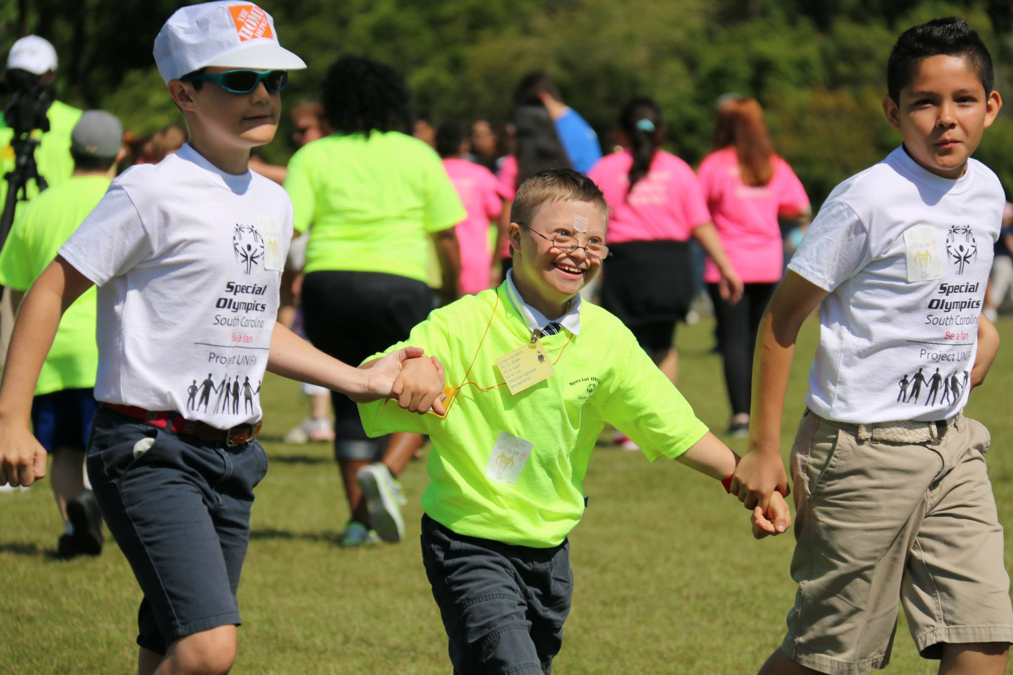
Defining a unified champion school…

Slide 29
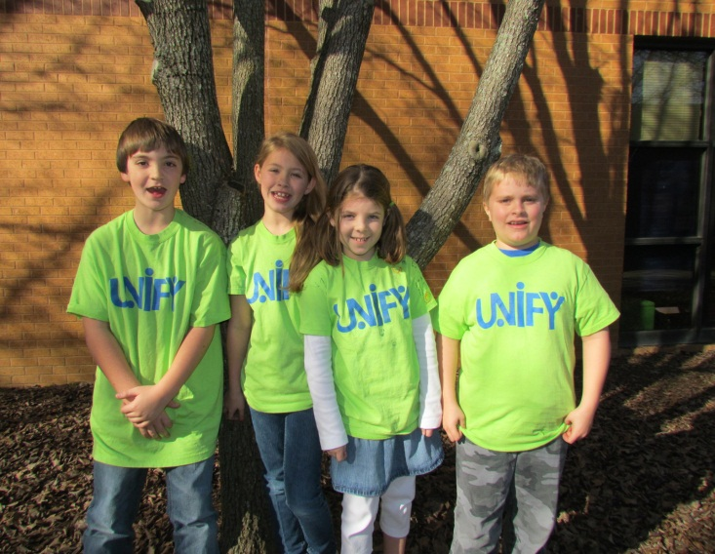
Unified Champion Schools
Unified Champion Schools seeks to change the atmosphere in preK-12 schools through sports programming giving opportunities to train and compete in Unified Sports. Students are also encouraged to build relationships and advocate for inclusion of Special Olympics athletes in their school communities, providing opportunities for true youth leadership for individuals with and without intellectual disabilities.

Slide 30
Unified champion school’s 3 components
Unified Sports
Youth Leadership & Activation
Whole-School Engagement

Slide 31
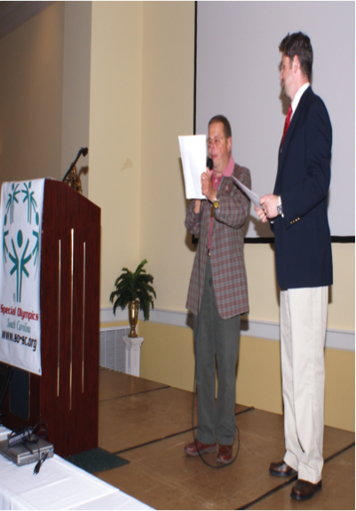
Athlete leadership programs
Athlete Leadership Programs is designed to offer positions in the organization for athletes who display leadership qualities. With training and support, athletes can become….
Certified Coaches
Certified Officials
Board Members
Global Messengers
Event Volunteer

Slide 32
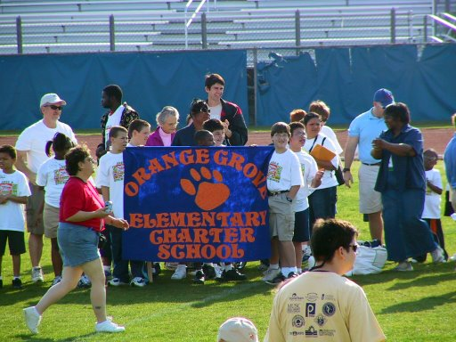
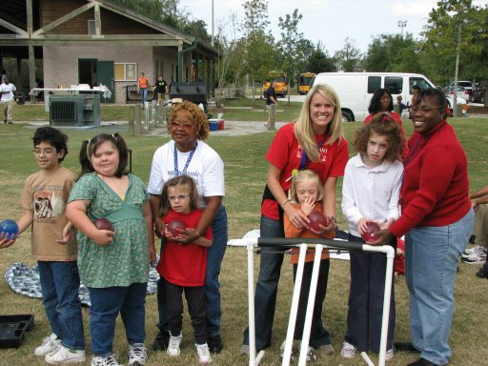
Power in partnerships
Special Olympics recognizes opportunities to partner with other organizations and groups to offer sports in a variety of ways and forums.
School Systems
Parks & Recreation
Sports Organizations
Other Nonprofits

Slide 33
fundraising
Approximately 70% of SOSC’s funding comes from loyal individual donors. Other funding is secured via corporate sponsors, special events, and grants.
The Law Enforcement Torch Run (LETR) helps to garner individual donations and holds special events through the efforts of officers and employees throughout the state.

Slide 34
Online resources
www.specialolympics.org
www.so-sc.org

